Slide 1
Image Processing and Pattern Recognition (IPPR):
(Lecture 6)

Slide 2
Contents
In this lecture we will look at image enhancement in the frequency domain
  Jean Baptiste Joseph Fourier
  The Fourier series & the Fourier transform
  Image Processing in the frequency domain
    Image smoothing
    Image sharpening
  Fast Fourier Transform

Slide 3
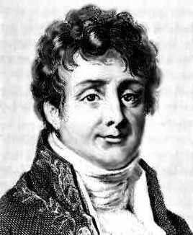
Jean Baptiste Joseph Fourier
Fourier was born in Auxerre,
France in 1768
  Most famous for his work “La Théorie Analitique de la Chaleur” published in 1822
  Translated into English in 1878: “The Analytic Theory of Heat”
Nobody paid much attention when the work was first published
One of the most important mathematical theories in modern engineering

Slide 4
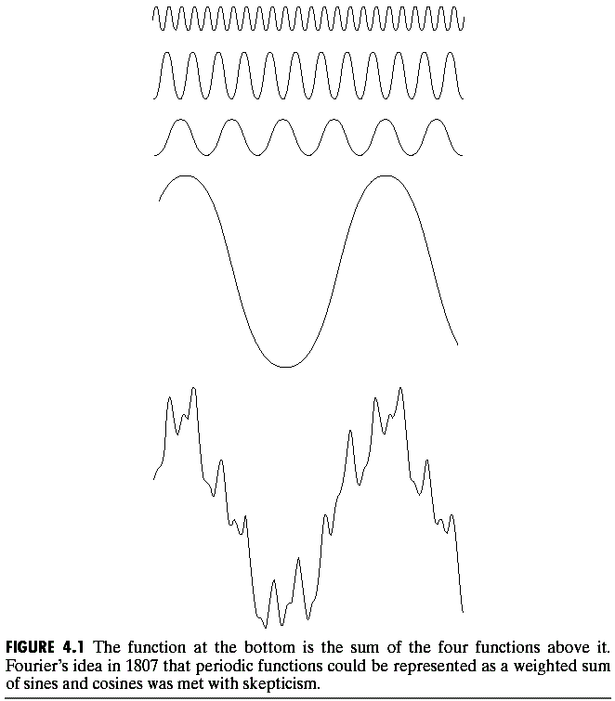
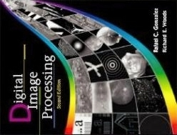
The Big Idea
=
Images taken from Gonzalez & Woods, Digital Image Processing (2002)
Any function that periodically repeats itself can be expressed as a sum of sines and cosines of different frequencies each multiplied by a different coefficient – a Fourier series
Finite curves can be expressed as the integral of sines / cosines multiplied by a weighing function- Fourier Transform

Slide 5
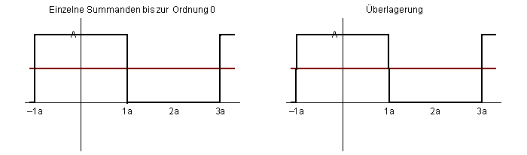
The Big Idea (cont…)
Taken from www.tfh-berlin.de/~schwenk/hobby/fourier/Welcome.html
Notice how we get closer and closer to the original function as we add more and more frequencies

Slide 6
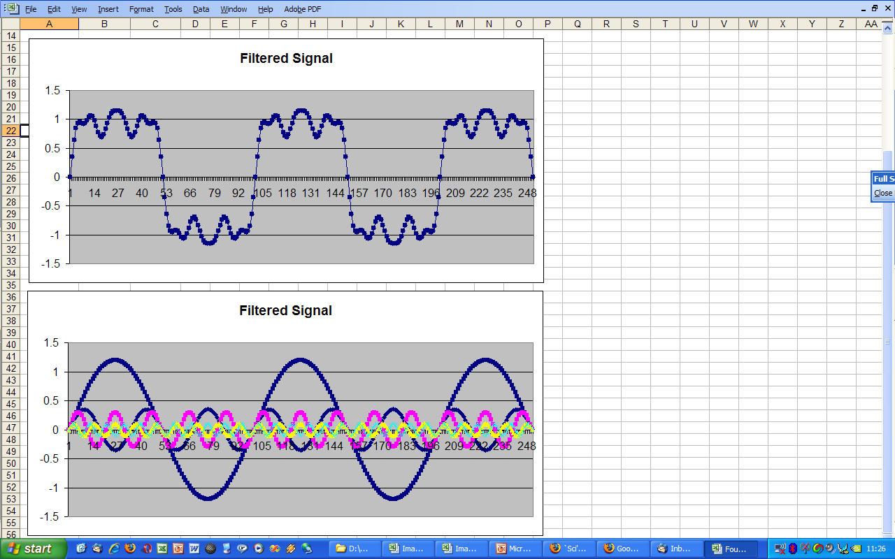
The Big Idea (cont…)
Frequency domain signal processing example in Excel

Slide 7
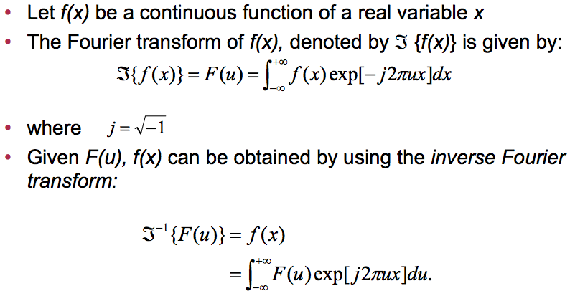
Introduction to the Fourier Transform

Slide 8
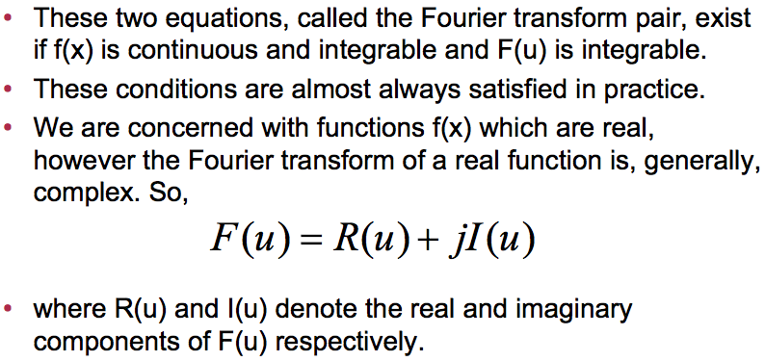
The Fourier Transform (continued)

Slide 9
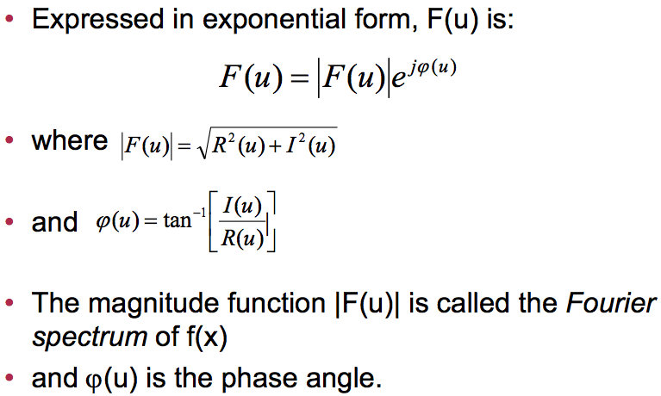
The Fourier Transform (continued)

Slide 10
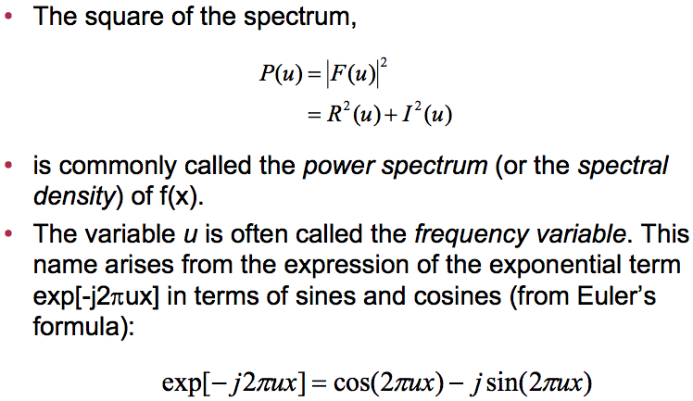
The Fourier Transform (continued)

Slide 11
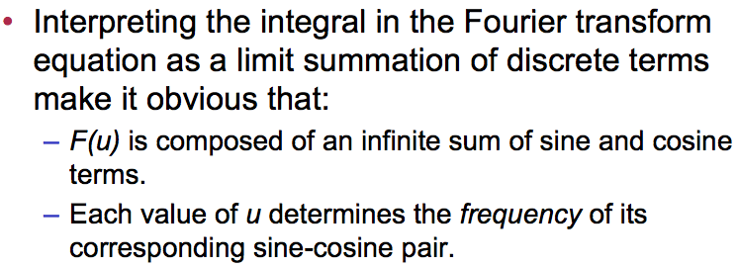
The Fourier Transform (continued)

Slide 12
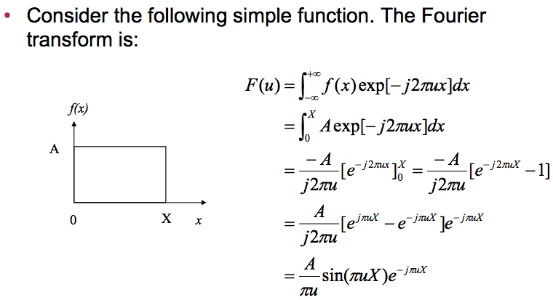
The Fourier Transform (Example)

Slide 13
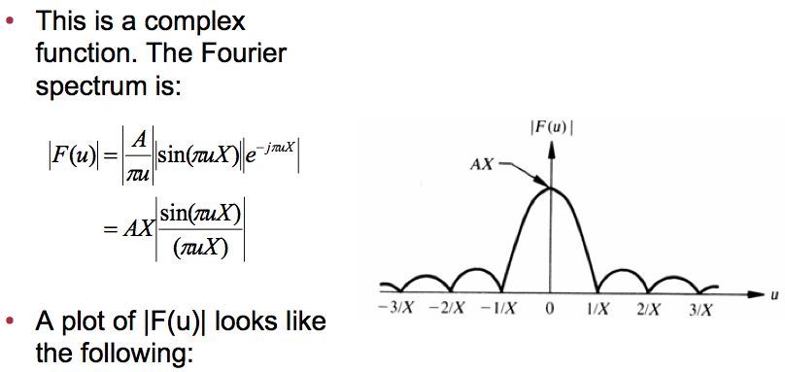
The Fourier Transform (Example)

Slide 14
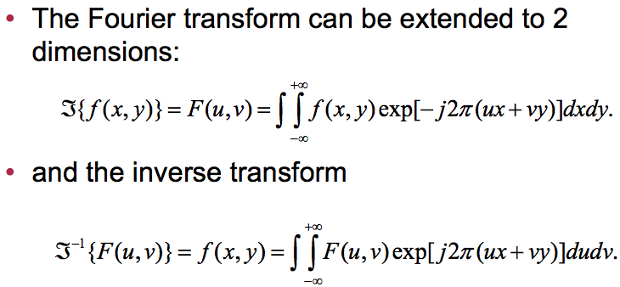
The 2-D Fourier Transform

Slide 15
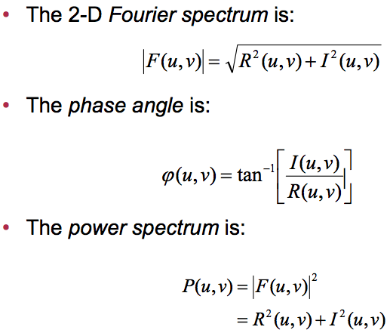
The 2-D Fourier Transform (Continued)

Slide 16
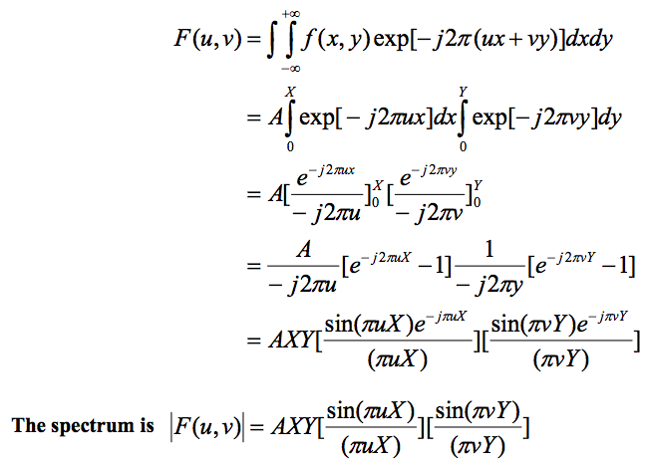
Example 2-D Fourier transform

Slide 17
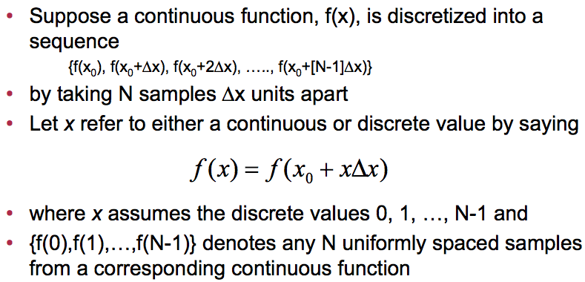
The discrete Fourier transform

Slide 18
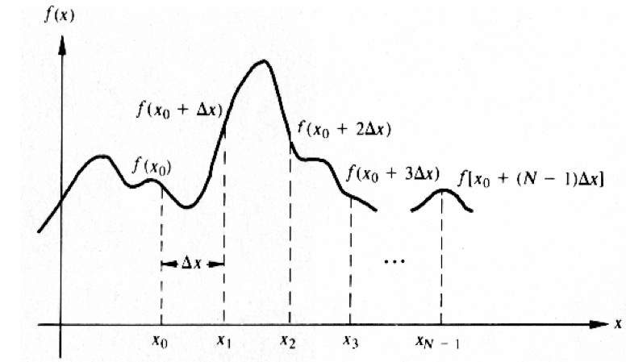
Sampling a continuous function

Slide 19
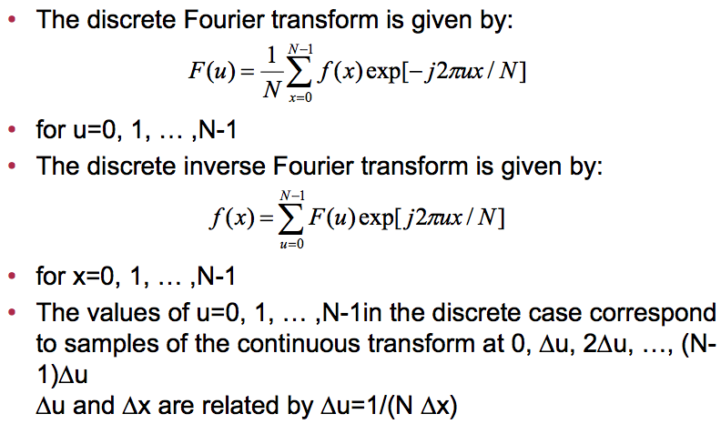
The discrete Fourier transform pair

Slide 20
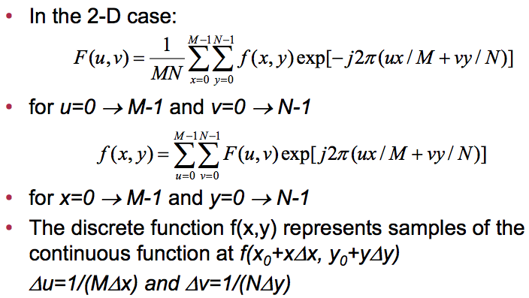
The 2-D discrete Fourier transform

Slide 21
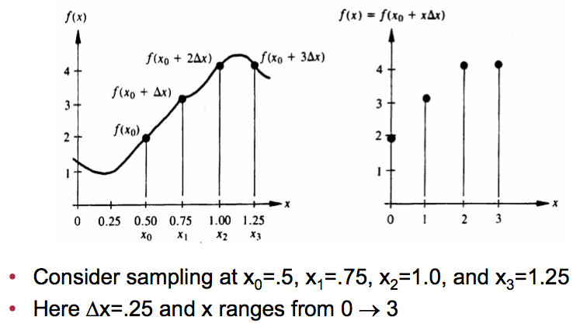
Discrete Fourier transform example

Slide 22
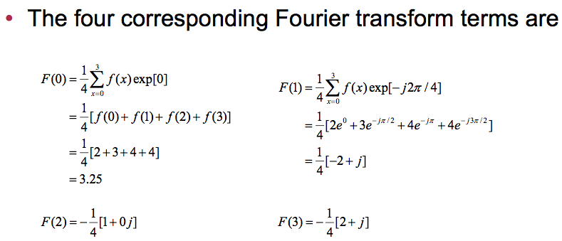
Discrete Fourier transform example (continued)

Slide 23
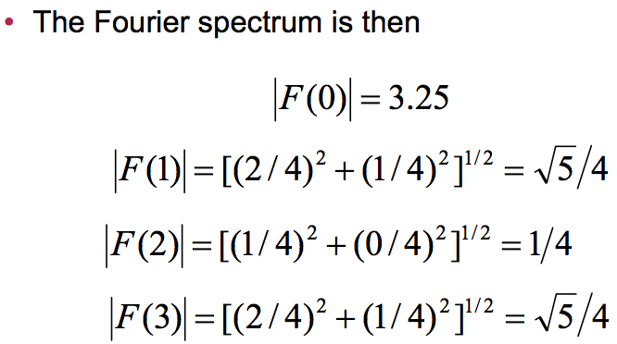
Discrete Fourier transform example (continued)

Slide 24
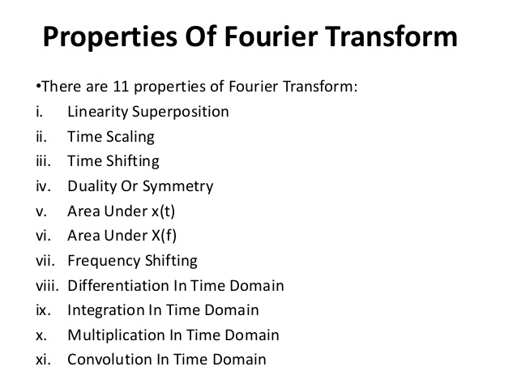
Properties of the Fourier transform

Slide 25
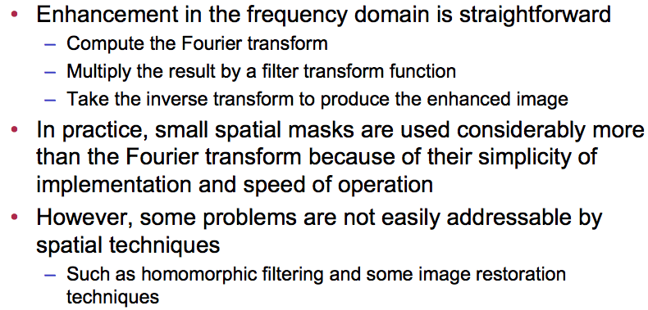
Frequency domain filtering

Slide 26
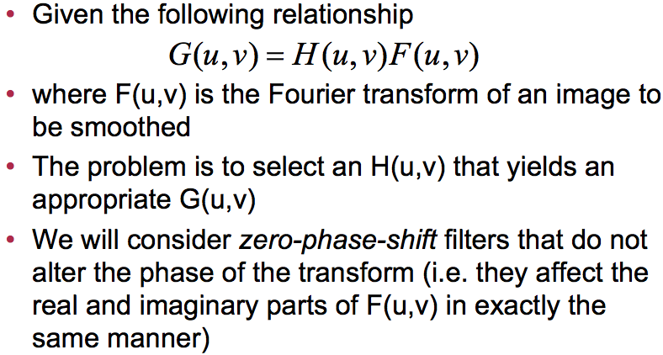
Lowpass frequency domain filtering

Slide 27
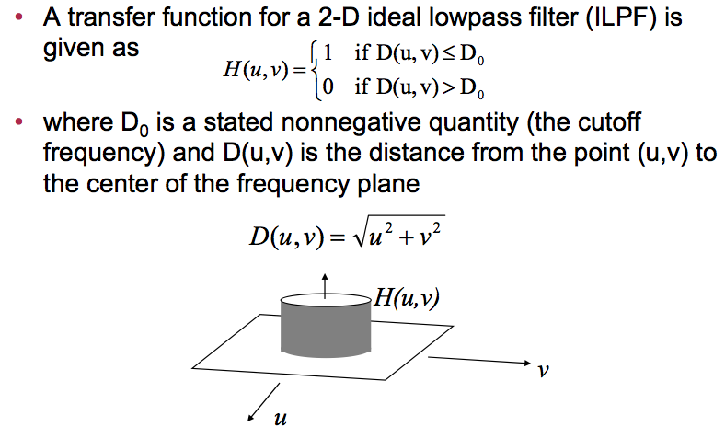
Ideal lowpass filter (ILPF)

Slide 28
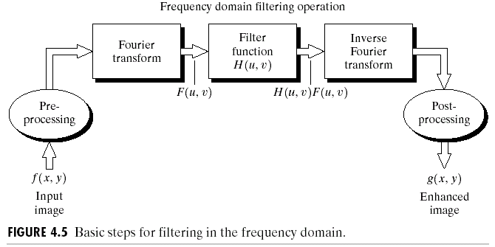
The DFT and Image Processing
Images taken from Gonzalez & Woods, Digital Image Processing (2002)

Slide 29
Smoothing Frequency Domain Filters
Smoothing is achieved in the frequency domain by dropping out the high frequency components
The basic model for filtering is:
G(u,v) = H(u,v)F(u,v)
where F(u,v) is the Fourier transform of the image being filtered and H(u,v) is the filter transform function
Low pass filters – only pass the low frequencies, drop the high ones

Slide 30
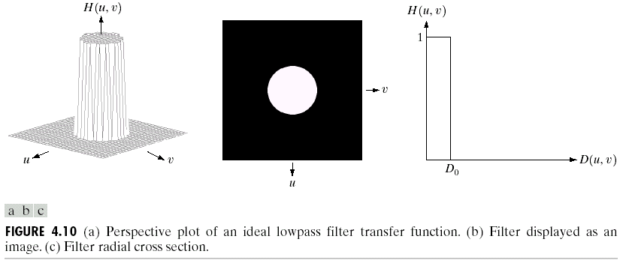
Ideal Low Pass Filter
Simply cut off all high frequency components that are a specified distance D₀ from the origin of the transform
changing the distance changes the behaviour of the filter
Images taken from Gonzalez & Woods, Digital Image Processing (2002)

Slide 31
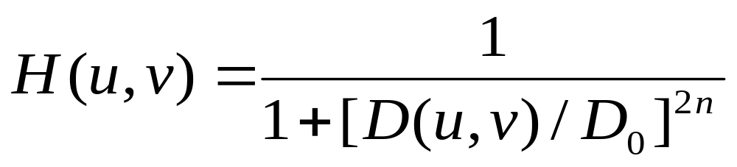
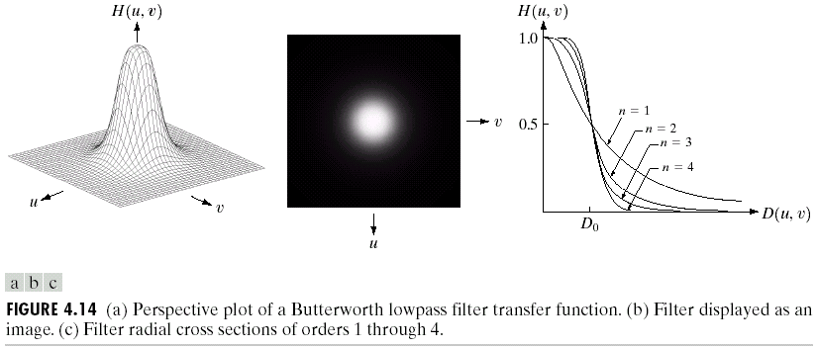
Butterworth Lowpass Filters
The transfer function of a Butterworth lowpass filter of order n with cutoff frequency at distance D₀ from the origin is defined as:
Images taken from Gonzalez & Woods, Digital Image Processing (2002)

Slide 32
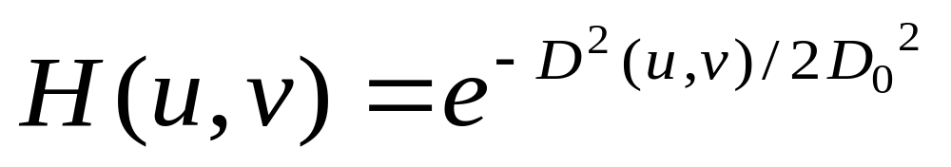
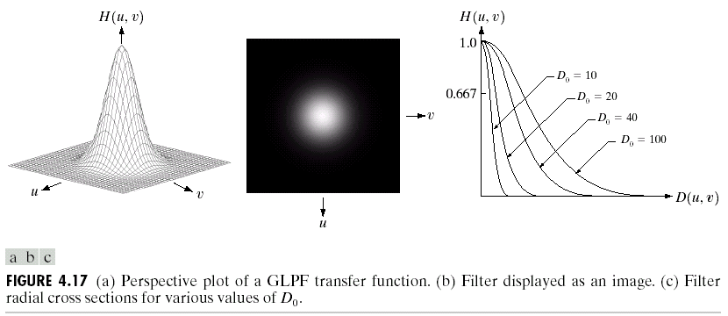
Gaussian Lowpass Filters
The transfer function of a Gaussian lowpass filter is defined as:
Images taken from Gonzalez & Woods, Digital Image Processing (2002)

Slide 33
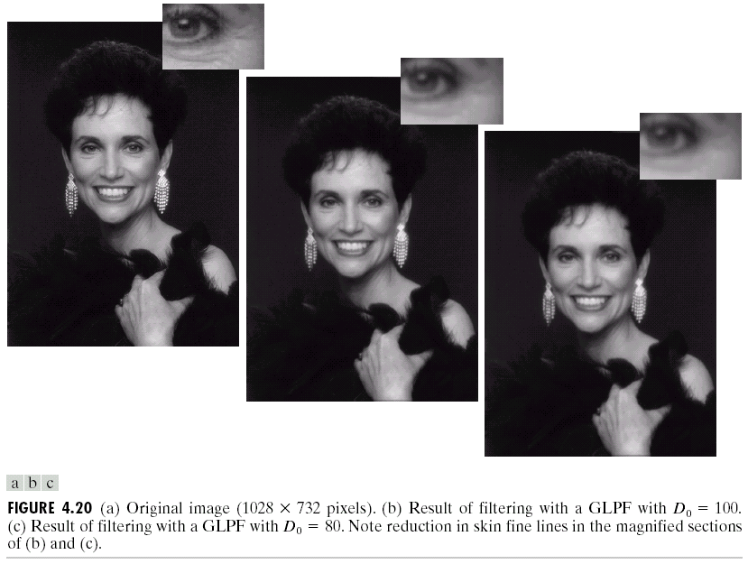
Lowpass Filtering Examples (cont…)
Different lowpass Gaussian filters used to remove blemishes in a photograph
Images taken from Gonzalez & Woods, Digital Image Processing (2002)

Slide 34
Lowpass Filtering Examples (cont…)
Images taken from Gonzalez & Woods, Digital Image Processing (2002)

Slide 35
Sharpening in the Frequency Domain
Edges and fine detail in images are associated with high frequency components
High pass filters – only pass the high frequencies, drop the low ones
High pass frequencies are precisely the reverse of low pass filters, so:
H_{hp}(u, v) = 1 – H_{lp}(u, v)

Slide 36
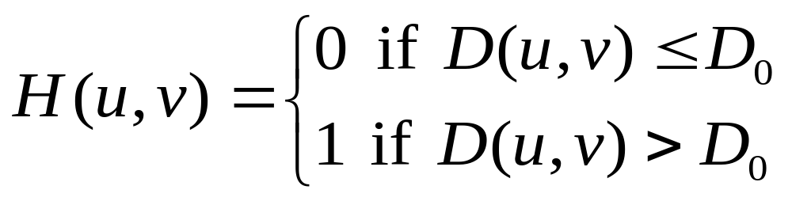
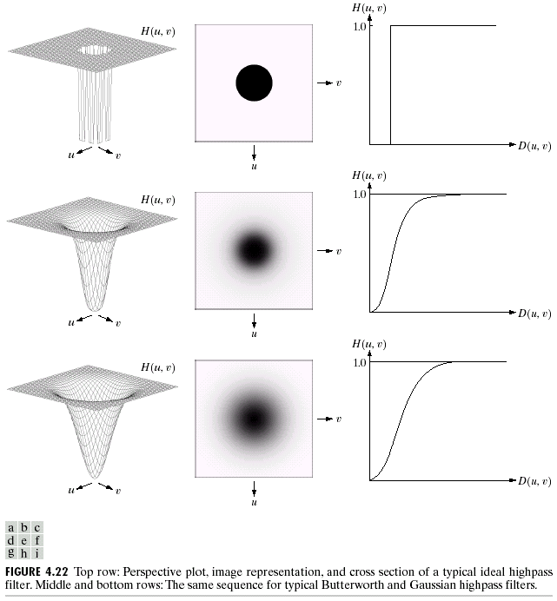
Ideal High Pass Filters
The ideal high pass filter is given as:
where D₀ is the cut off distance as before
Images taken from Gonzalez & Woods, Digital Image Processing (2002)

Slide 37
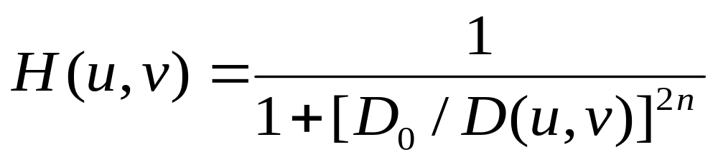
Butterworth High Pass Filters
The Butterworth high pass filter is given as:
where n is the order and D₀ is the cut off distance as before
Images taken from Gonzalez & Woods, Digital Image Processing (2002)

Slide 38
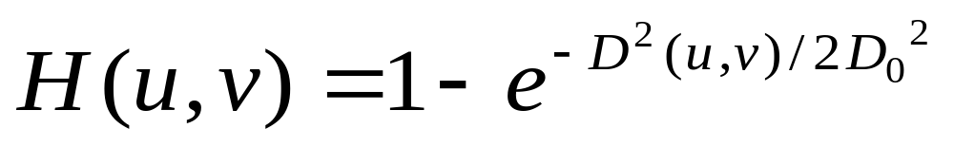
Gaussian High Pass Filters
The Gaussian high pass filter is given as:
where D₀ is the cut off distance as before
Images taken from Gonzalez & Woods, Digital Image Processing (2002)

Slide 39
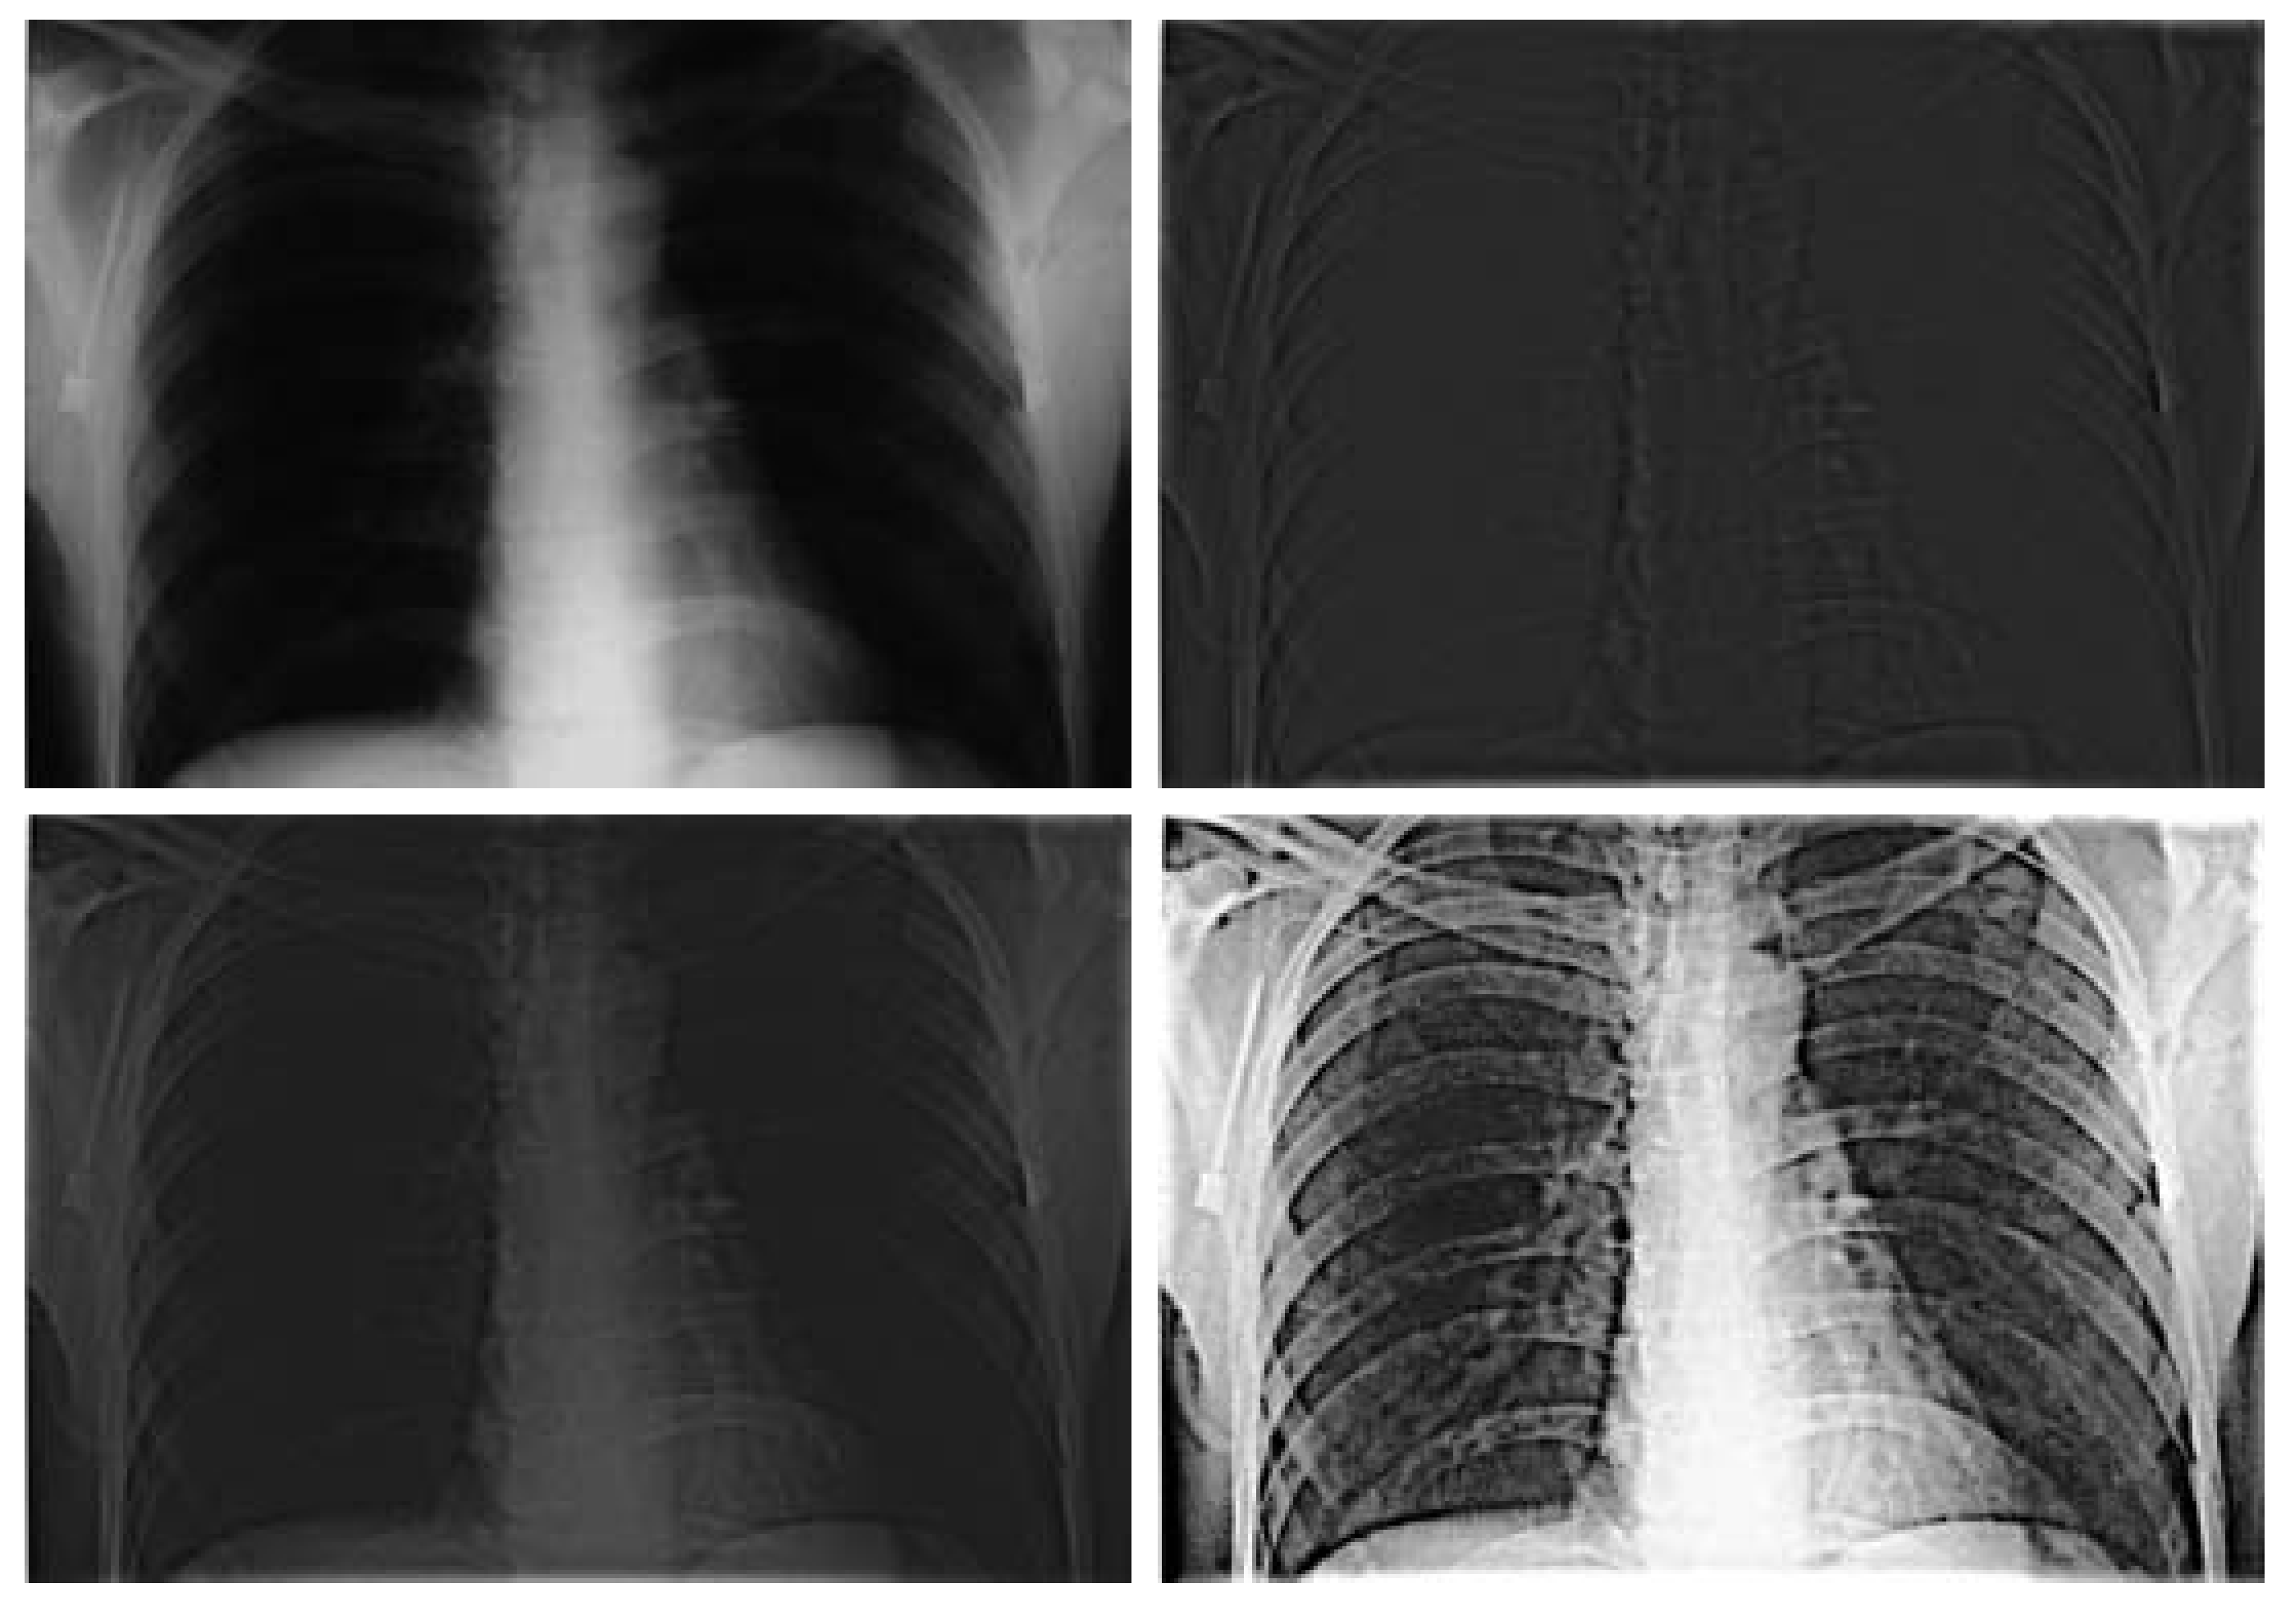
Highpass Filtering Example
Original image
Highpass filtering result
Images taken from Gonzalez & Woods, Digital Image Processing (2002)
High frequency emphasis result
After histogram equalisation

Slide 40
Highpass Filtering Example

Slide 41
Highpass Filtering Example

Slide 42
Highpass Filtering Example

Slide 43
Highpass Filtering Example

Slide 44
Fast Fourier Transform
The reason that Fourier based techniques have become so popular is the development of the Fast Fourier Transform (FFT) algorithm
Allows the Fourier transform to be carried out in a reasonable amount of time
Reduces the amount of time required to perform a Fourier transform by a factor of 100 – 600 times!

Slide 45
Frequency Domain Filtering & Spatial Domain Filtering
Similar jobs can be done in the spatial and frequency domains
Filtering in the spatial domain can be easier to understand
Filtering in the frequency domain can be much faster – especially for large images

